Slide 1
Ovarian Cancer RAD51D

Slide 2
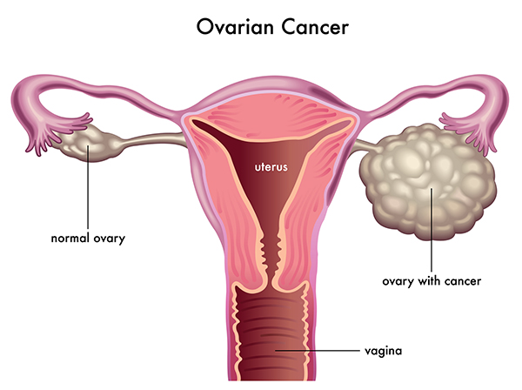
What is Ovarian Cancer?
Notes:
https://universityhealthnews.com/daily/cancer/respond-quickly-to-ovarian-cancer-symptoms/

Slide 3
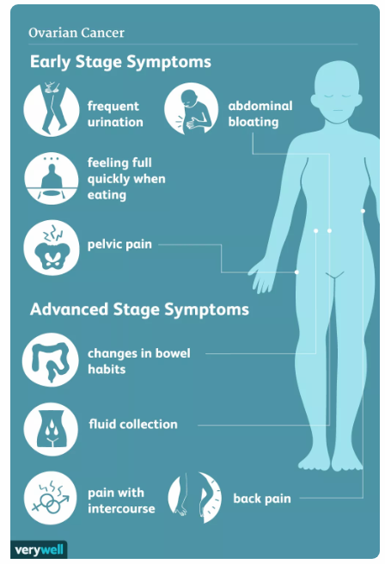
What are Symptoms of Ovarian Cancer?
Notes:
https://www.verywellhealth.com/ovarian-cancer-causes-risk-factors-2509671

Slide 4
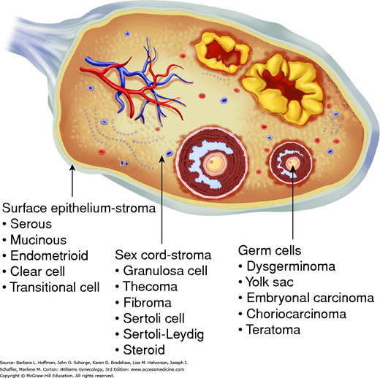
What are the different Cells of the Ovaries?
Protects Ovary
Produces Steroid Hormones
Produces Egg Cells
Notes:
https://obgynkey.com/chapter-36-ovarian-germ-cell-and-sex-cord-stromal-tumors/

Slide 5
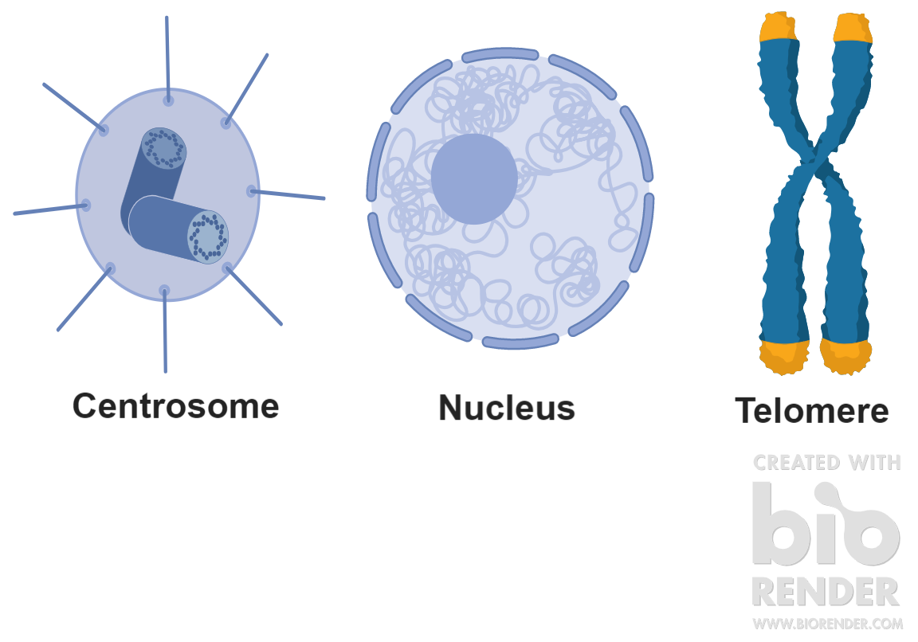
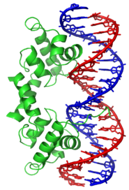
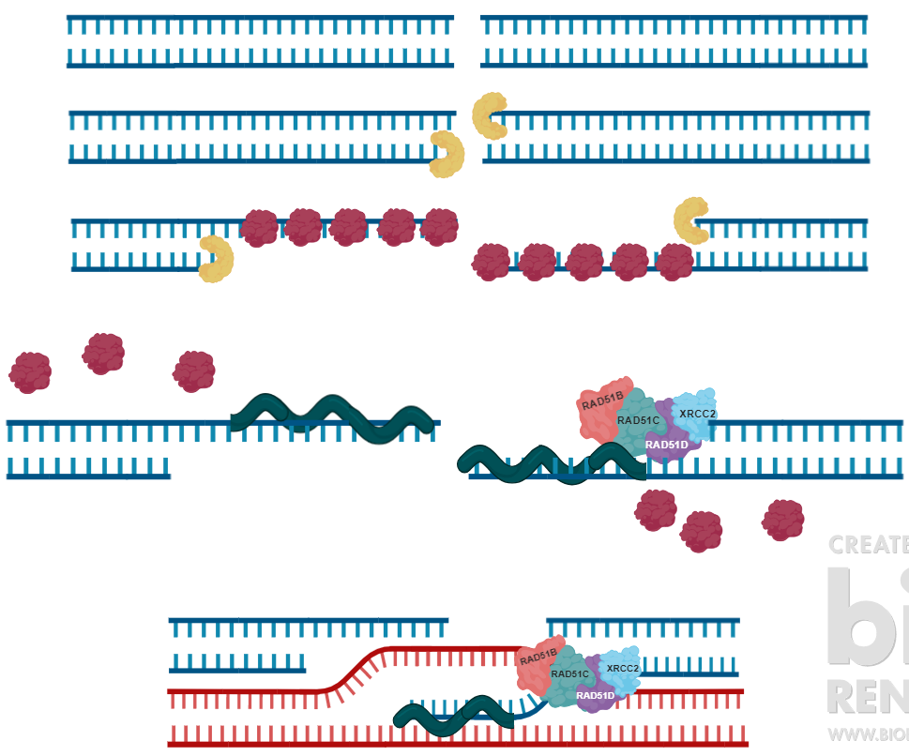
What is the Role of RAD51D?
2KZ3|A
RAD51/AAA
328
ssDNA Binding
BRC Repeats
C-terminus DNA Binding/ATPase
Cellular Component
Molecular Function
Biological Processes
Notes:
Biorender

Slide 6
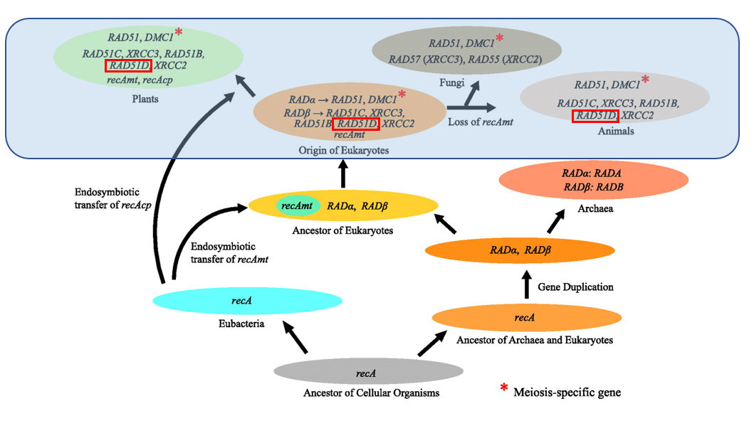
What is the Evolutionary History of RAD51D?
©2006 by National Academ of Sciences
Notes:
A model of the evolutionary history of recA/RAD51 gene family. The gene duplication that occurred before the divergence of archaea and eukaryotes gave rise to two lineages, RADα and RADβ, and, in eubacteria, recA has remained as a single-copy gene. In eukaryotes, both RADα and RADβ genes experienced several duplication events, but, in archaea, they remained as single-copy genes. Eukaryotic recA genes originated from proteobacteria (recAmt) and cyanobacteria (recAcp) recA genes after two separate endosymbiotic events. recAmts were subsequently lost in the ancestors of animals and fungi.
Figure: https://www.pnas.org/content/103/27/10328

Slide 7
What’s RAD51D’s Role in Homology Repair?
Exonuclease
RPA
RAD51
Notes:
Biorender

Slide 8
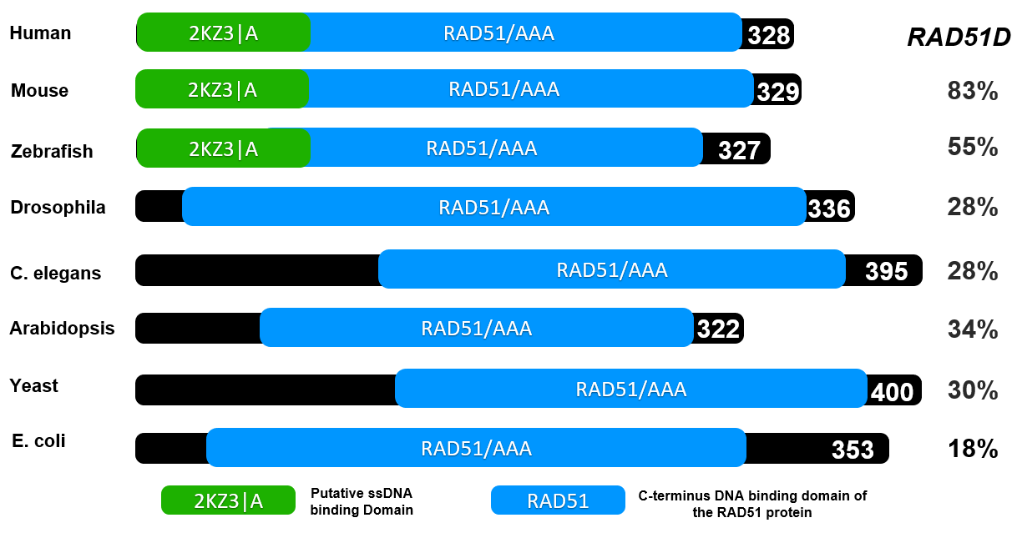
Is the RAD51 Domain Conserved Across Species?

Slide 9
Model Organism 1: Mus musculus
Similar Physiology to Humans
-Can supplement hormones in Feed
Xenografting Tools
-Ovarian Tumor Model
Genetic Engineering Tools
-Ovarian Specific Expression
Similar Ovarian Microenvironment

Slide 10
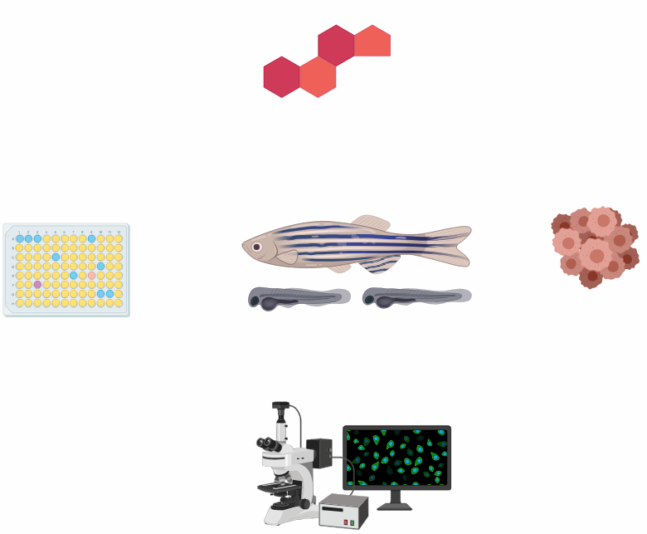
Model Organism 2: Danio rerio
Steroid Hormone Receptors
Xenografting Tools
-Ovarian Tumor Model
Cheap and Fast Genetic Screens
Good For Fluorescent Microscopy

Slide 11
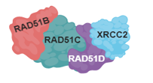
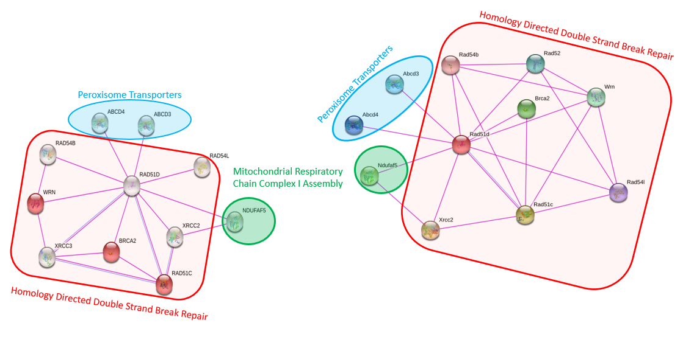
RAD51D is a Part of the BCDX2 Complex
Mouse
Human

Slide 12
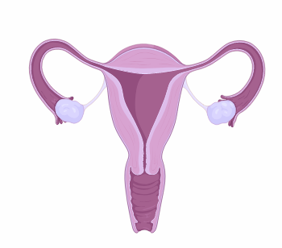
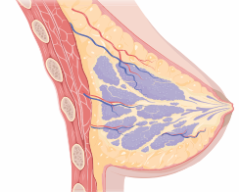
Why Do RAD51D Mutations Have Tissue Specific Phenotypes?
“Large-scale meta-analysis of mutations identified in panels of breast/ovarian cancer-related genes — Providing evidence of cancer predisposition genes”
•Profiles of genes contributing to breast and ovarian cancer differ substantially.
•RAD51C, RAD51D, and BRIP1 are proved to be high-risk ovarian, but not breast cancer genes.
Vs.

Slide 13
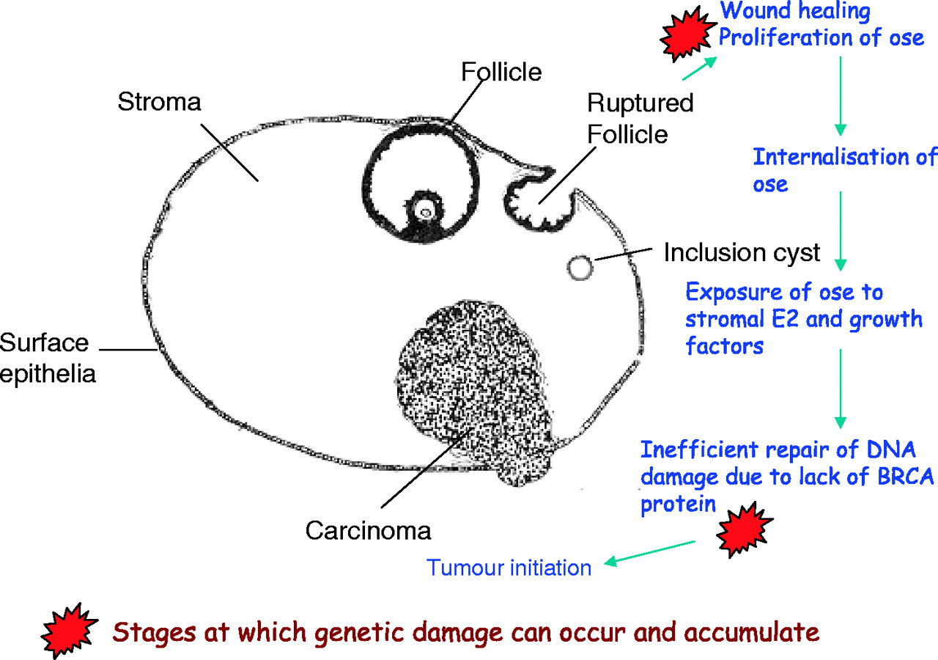
Can the Microenvironment of the Ovary Explain the Phenotype?
Notes:
https://doi.org/10.1093/carcin/bgi136

Slide 14
How Does Estrogen Cause DNA Damage?

Slide 15
How Does Estrogen Cause DNA Damage?

Slide 16
How Does Estrogen Cause DNA Damage?

Slide 17
What About RAD51-Independent Repair?
SSA
NHEJ

Slide 18
What About RAD51-Independent Repair?
SSA

Slide 19
What About RAD51-Independent Repair?
?

Slide 20
What About RAD51-Independent Repair?
?

Slide 21
What About RAD51-Independent Repair?
SLIDE WITH
FIGURES NOT USED

Slide 22
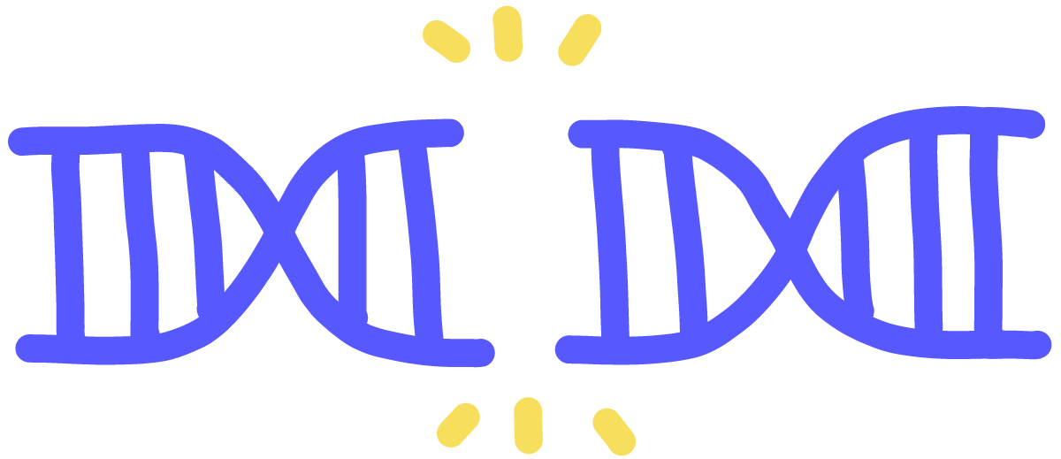
What is the Primary Goal?
To better understand how the microenvironment of the ovaries and RAD51D interact to influence DNA Repair
Aim 1:
Characterize conserved domains and motifs in RAD51D that are crucial for ovarian integrity.
Aim 2:
Identify small molecules that alter ovarian genomic stability in both WT and mutant RAD51D
Aim 3:
Identify the role of putative Phosphorylation Sites on the RAD51D Protein
Notes:
https://innovativegenomics.org/resources/educational-materials/glossary/double-strand-break/

Slide 23
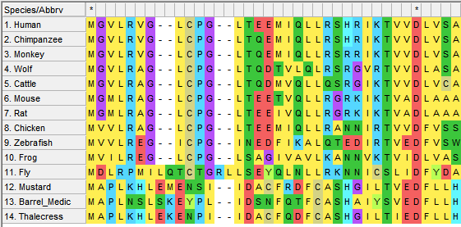
Aim 1: Characterize Conserved Domains Essential for Ovarian Integrity
Clustal W
Cre - Loxp
Quantify Repair
Identify Homologs Using Blastp
Compare RAD51D in vertebrate ovaries vs. non-vertebrates
Notes:
https://blast.ncbi.nlm.nih.gov/Blast.cgi

Slide 24
Aim 1: Characterize Conserved Domains Essential for Ovarian Integrity
Clustal W
Cre - Loxp
Quantify Repair

Slide 25
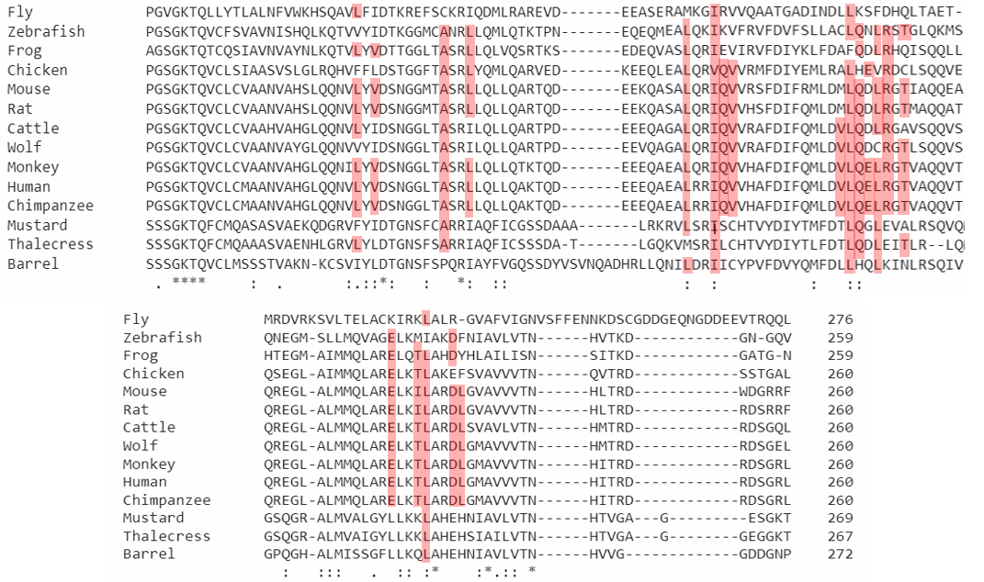
Aim 1: Characterize Conserved Domains Essential for Ovarian Integrity
Clustal W
Cre - Loxp
Quantify Repair
May NOT USE
Notes:
Walker A: 107G, 108G, 109P, 110G(US), 111S(US), 112G(US/Likely Pathogenic), 113K(US), 114T

Slide 26
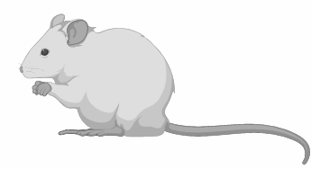
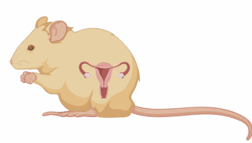
Aim 1: Characterize Conserved Domains Essential for Ovarian Integrity
Clustal W
Cre - Loxp
Quantify Repair
LoxP
LoxP
ovarian p
CRE
nP
RAD51D Gene
CRE
Notes:
Mice: Biorender
Adapted from https://www.jax.org/news-and-insights/jax-blog/2014/december/the-abcs-of-choosing-a-cre-strain-to-generate-ko-mice

Slide 27
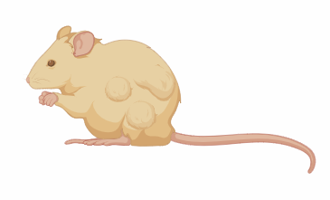
Aim 1: Characterize Conserved Domains Essential for Ovarian Integrity
Clustal W
Cre - Loxp
Assess DNA Repair
Quantify tumorigenesis in the ovaries

Slide 28
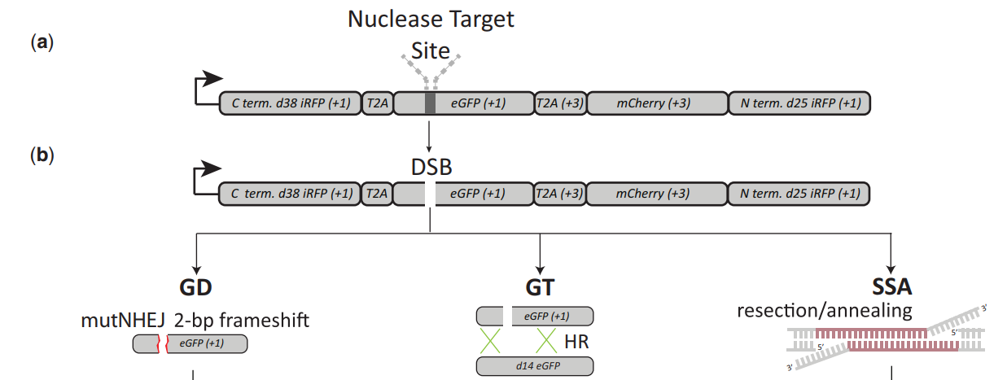
Aim 1: Characterize Conserved Domains Essential for Ovarian Integrity
Clustal W
Cre - Loxp
Assess DNA Repair
Notes:
https://www.researchgate.net/publication/257754595_Novel_fluorescent_genome_editing_reporters_for_monitoring_DNA_repair_pathway_utilization_at_endonuclease-induced_breaks

Slide 29
Aim 1: Characterize Conserved Domains Essential for Ovarian Integrity
Clustal W
Cre - Loxp
Assess DNA Repair
WT
Mutant A: no ssDNA Binding
Mutant B: No BCDX2 Binding?
Notes:
Traffic Light: https://i.pinimg.com/originals/28/ff/6f/28ff6f46d418860eacb64f4d62a86a96.jpg

Slide 30
Aim 1: Characterize Conserved Domains Essential for Ovarian Integrity
Clustal W
Cre - Loxp
Assess DNA Repair
WT
Mutant A: no ssDNA Binding
Mutant B: No BCDX2 Binding?
Notes:
Traffic Light: https://i.pinimg.com/originals/28/ff/6f/28ff6f46d418860eacb64f4d62a86a96.jpg

Slide 31
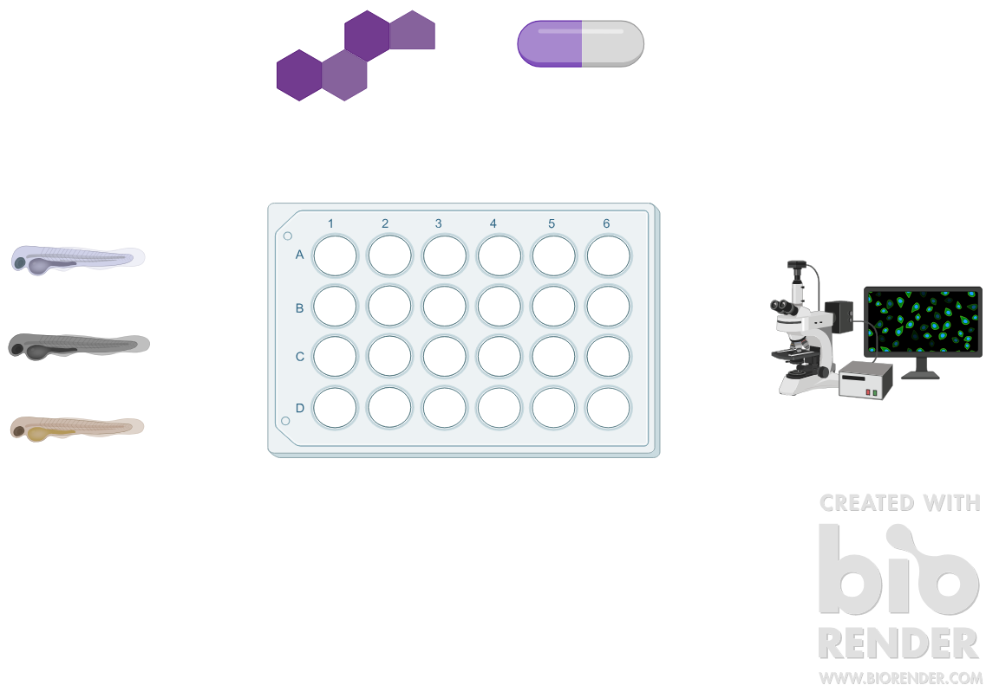
Aim 2: Identify small molecules that affect ovarian genetic integrity
Chemical Genomic Screen
Assess DNA Repair

Slide 32
Aim 2: Identify small molecules that affect ovarian genetic integrity
Chemical Genomic Screen
Assess DNA Repair

Slide 33
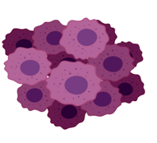
Aim 2: Identify small molecules that affect ovarian genetic integrity
Chemical Genomic Screen
Assess DNA Repair

Slide 34
Aim 3: Identify the Role of RAD51D PTM and DNA Repair
Clustal W
Proteomic Tools
CRISPR-Cas-9 Mice Knock-in
Assess DNA Repair
Notes:
https://www.phosphosite.org/proteinAction?id=9321&showAllSites=true

Slide 35
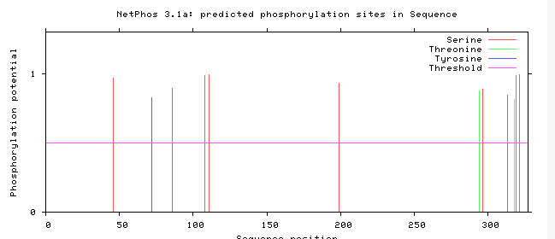
Aim 3: Identify the Role of RAD51D PTM and DNA Repair
Clustal W
Proteomic Tools
CRISPR-Cas-9 Mice Knock-in
Assess DNA Repair
Notes:
https://www.phosphosite.org/proteinAction?id=9321&showAllSites=true

Slide 36
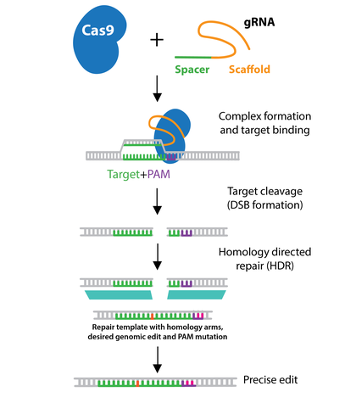
Aim 3: Identify the Role of RAD51D PTM and DNA Repair
Clustal W
Proteomic Tools
CRISPR-Cas-9 Zebrafish Knock-in
Assess DNA Repair
Will Create a better Figure for CRISPR
Notes:
https://www.addgene.org/crispr/guide/

Slide 37
Aim 3: Identify the Role of RAD51D PTM and DNA Repair
Clustal W
Proteomic Tools
CRISPR-Cas-9 Mice Knock-in
Assess DNA Repair
Notes:
https://www.phosphosite.org/proteinAction?id=9321&showAllSites=true

Slide 38
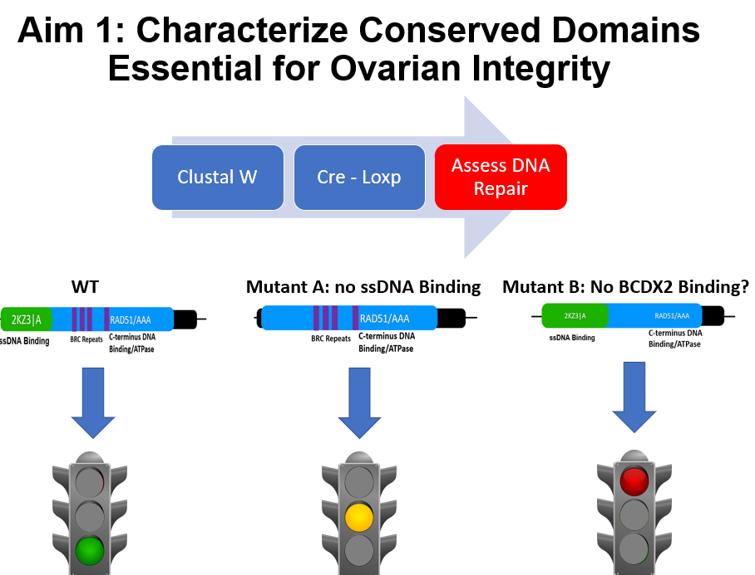
Summary
Identify Conserved Amino Acids that are important for Ovarian integrity
Identify Hormones and Small Molecules that alter DNA repair in ovarian cells
Identify the role of uncharacterized PTM in RAD51D and its affect on DNA Repair

Slide 39
References
1. Ovarian Tumor: https://tat.gu.se/digitalAssets/1331/1331718_tum--r.jpg
2. Ovary Image: https://universityhealthnews.com/daily/cancer/respond-quickly-to-ovarian-cancer-symptoms/
3. Symptoms: https://www.verywellhealth.com/ovarian-cancer-causes-risk-factors-2509671
4. Cell Types: https://obgynkey.com/chapter-36-ovarian-germ-cell-and-sex-cord-stromal-tumors/
5. Biorender: https://biorender.com/ , DNA Binding: https://en.wikipedia.org/wiki/DNA-binding_protein
6. Rad51 Family: https://www.pnas.org/content/103/27/10328
7. Biorender: https://biorender.com/
9-10. Biorender: https://biorender.com/
11. Biorender: https://biorender.com/ , STRING: https://string-db.org/cgi/network.pl
7-11. Biorender: https://biorender.com/
12. Biorender: https://biorender.com/
13. Ovarian Figure: https://doi.org/10.1093/carcin/bgi136
14-21. Biorender: https://biorender.com/
22. Double Stand Break Cartoon: https://innovativegenomics.org/resources/educational-materials/glossary/double-strand-break/
23. Blastp: https://blast.ncbi.nlm.nih.gov/Blast.cgi, MEGA: https://www.megasoftware.net/
24. MEGA: https://www.megasoftware.net/
25. Clustal Omega: https://www.ebi.ac.uk/Tools/msa/clustalo/
26. Biorender: https://biorender.com/
27. Biorender: https://biorender.com/
28. TLR: https://www.researchgate.net/publication/257754595_Novel_fluorescent_genome_editing_reporters_for_monitoring_DNA_repair_pathway_utilization_at_endonuclease-induced_breaks
29. Traffic Light: Traffic Light: https://i.pinimg.com/originals/28/ff/6f/28ff6f46d418860eacb64f4d62a86a96.jpg
30. Traffic Light: Traffic Light: https://i.pinimg.com/originals/28/ff/6f/28ff6f46d418860eacb64f4d62a86a96.jpg
31. Biorender: https://biorender.com/
32. Biorender: https://biorender.com/ , Traffic Light: https://i.pinimg.com/originals/28/ff/6f/28ff6f46d418860eacb64f4d62a86a96.jpg
33. Biorender: https://biorender.com/
34. Phosphosite: https://www.phosphosite.org/proteinAction?id=9321&showAllSites=true
35. Phosphosite: https://www.phosphosite.org/proteinAction?id=9321&showAllSites=true

Slide 40
References
35. Crispr: https://www.addgene.org/crispr/guide/
36. Traffic Light: https://i.pinimg.com/originals/28/ff/6f/28ff6f46d418860eacb64f4d62a86a96.jpg

